Slide 2
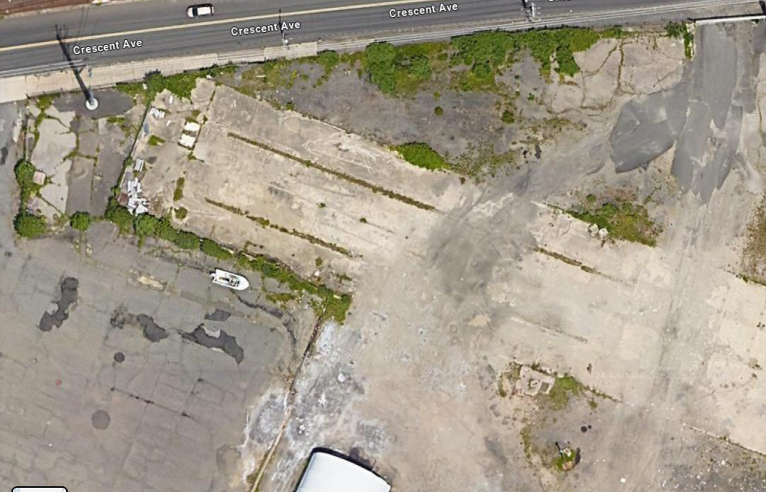
PCCI Irregular Premises ~ 1 acre
276’
68’
67’
42’
166’
246’
Distance from Concrete Base/Fence on South Side of Premises to Boundary ~10’
Distance from South Side of Premies to Salt Building = 70’
54’
70’

